Slide 1

Olist Ecommerce Performance Analysis
A Cross-Platform Data Deep Dive
GROUP 3

Slide 2
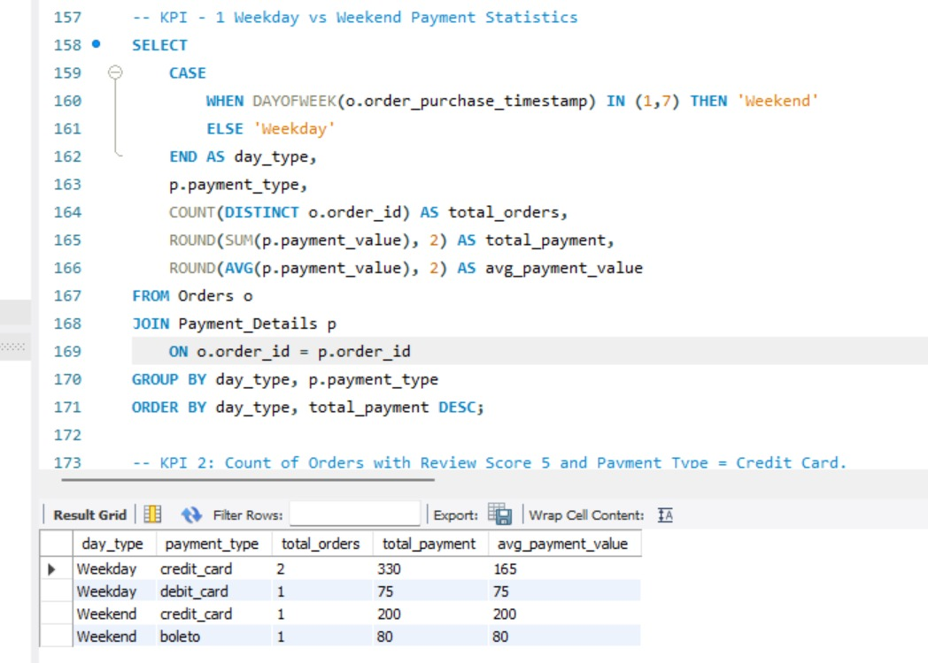
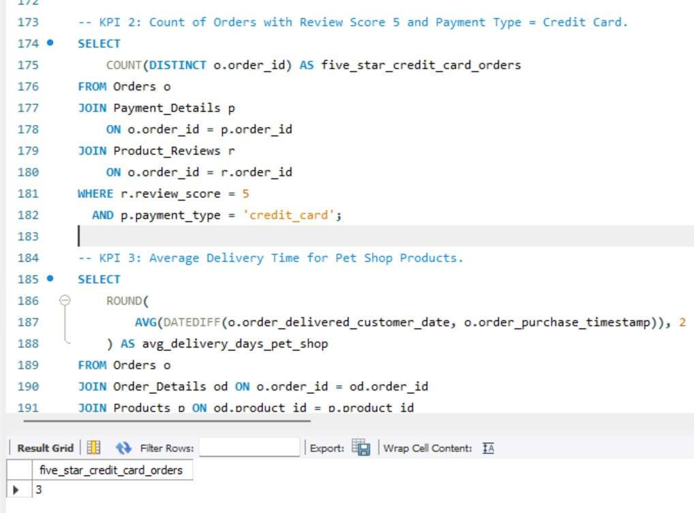
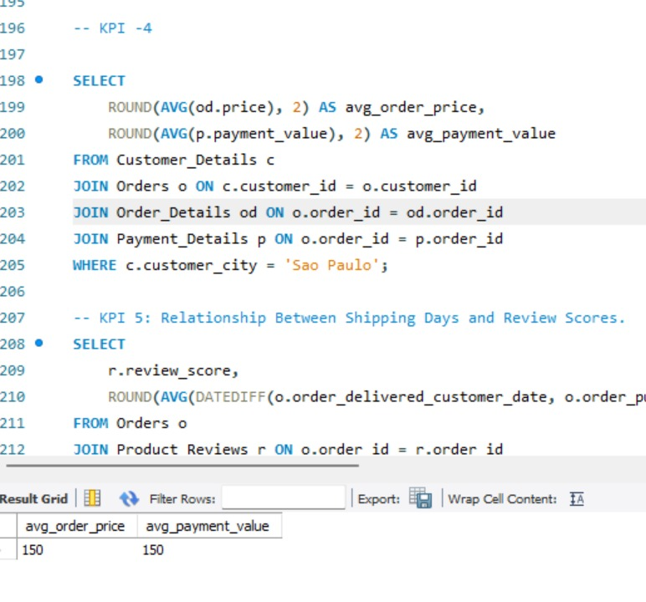
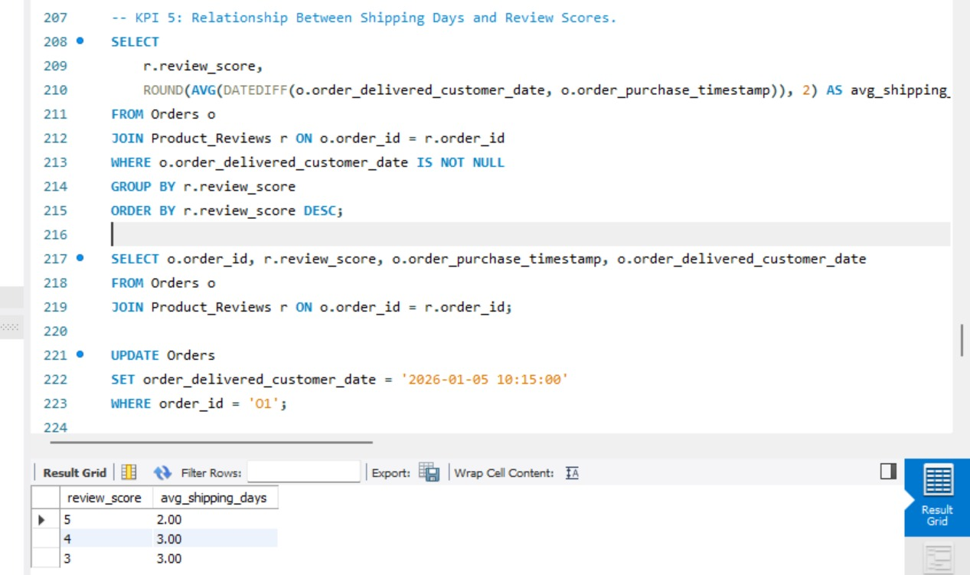
Market Reach Through KPI’s

Slide 3
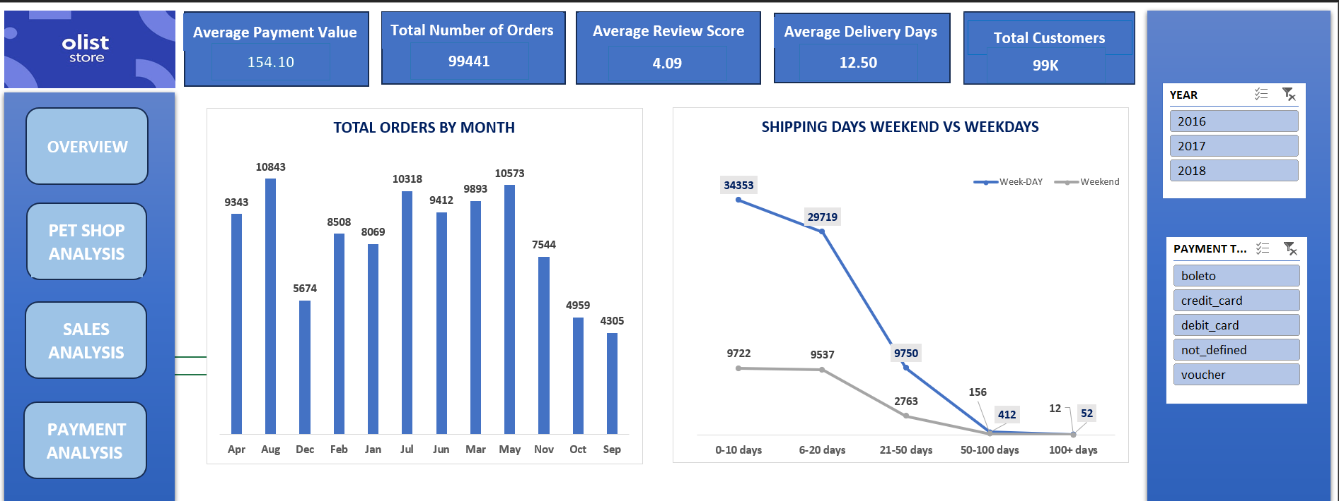
Executive Performance Overview
99.44K total platform orders
4.09 average review score
99K total customers reached

Slide 4
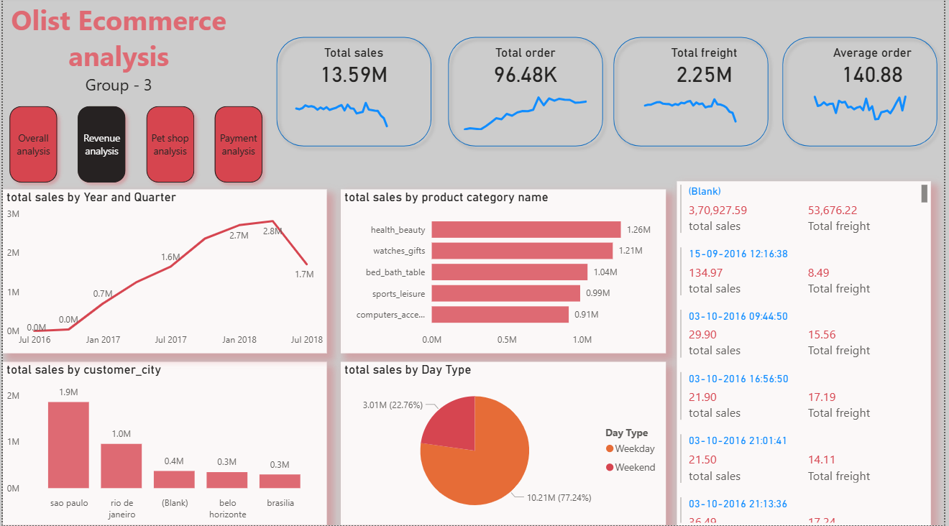
Revenue Growth Trajectory
$13.59M total platform sales
Peak revenue $2.8M (2018)
Sao Paulo leading city

Slide 5
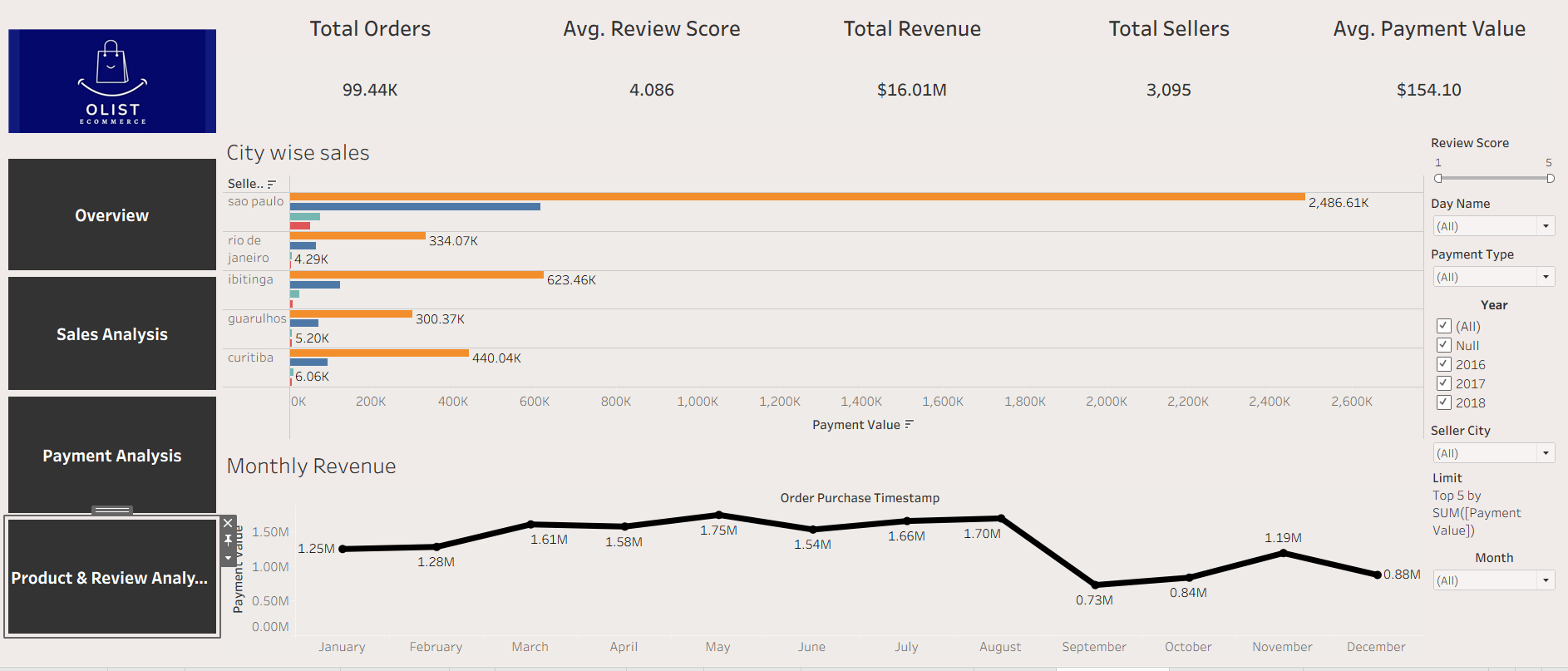
Monthly Revenue Volatility
$16.01M total payments realized
September revenue slump identified
3,095 active platform sellers

Slide 6
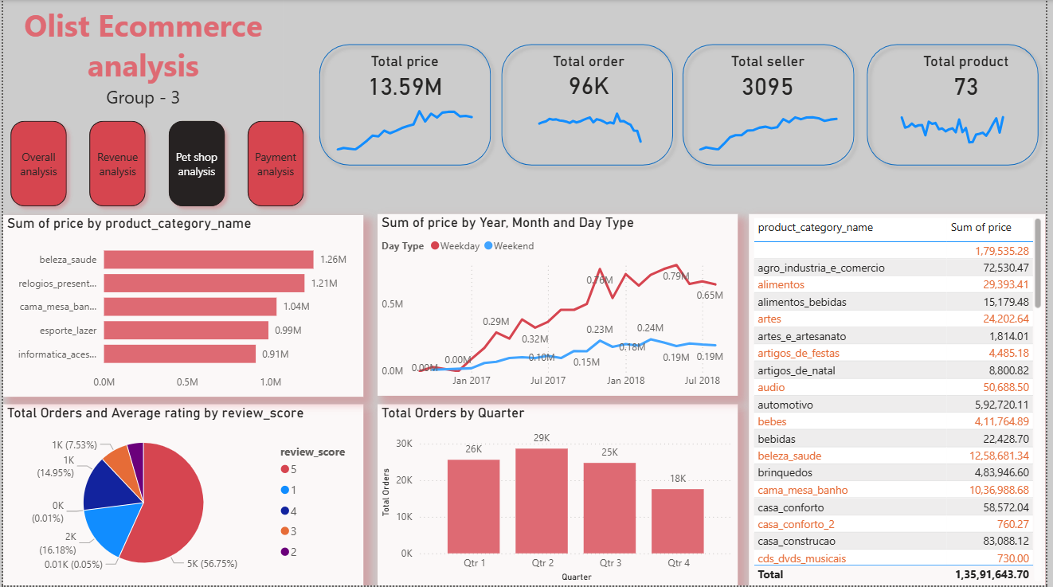
Top Category Performance
Health/Beauty #1 revenue driver.
73 unique product categories.
Q2 highest order volume.

Slide 7
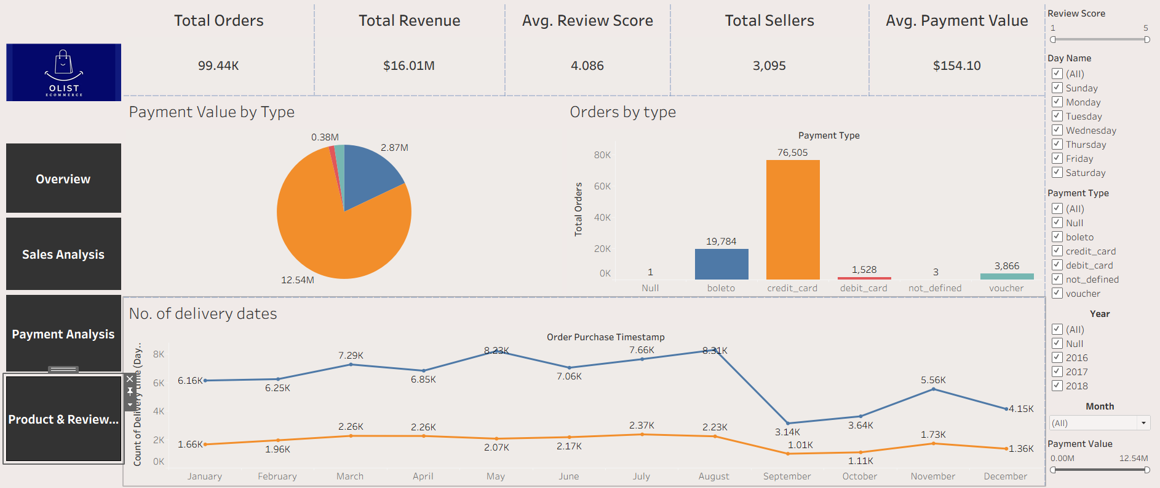
Payment Method Preferences
Credit cards dominate payments
77% weekday order volume
Boleto second preferred method

Slide 8
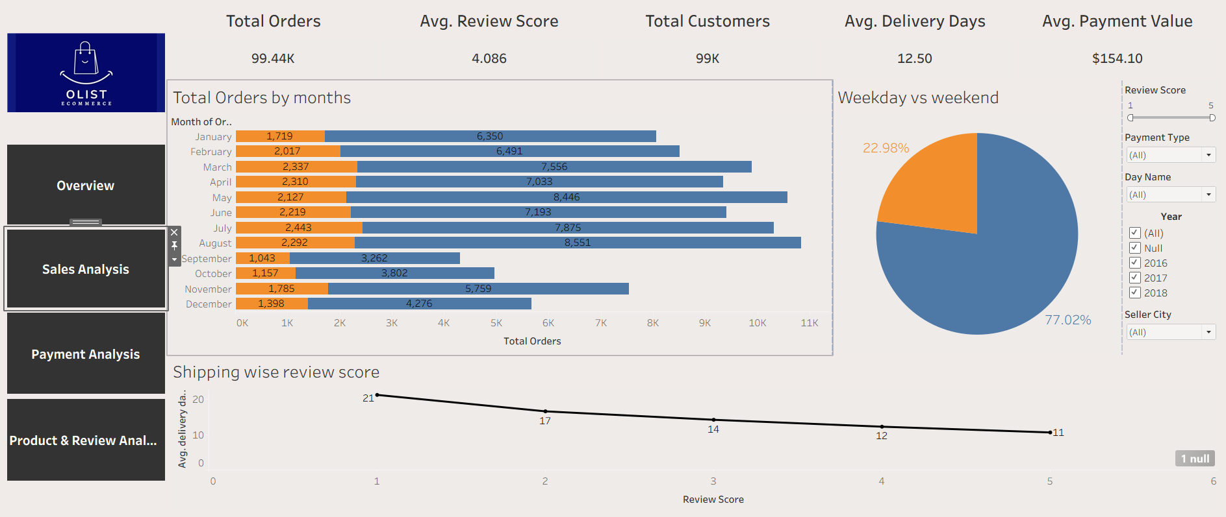
Logistics & Satisfaction Correlation
11-day delivery earns 5-stars
21-day delivery yields 1-star
12.50 average delivery days

Slide 9
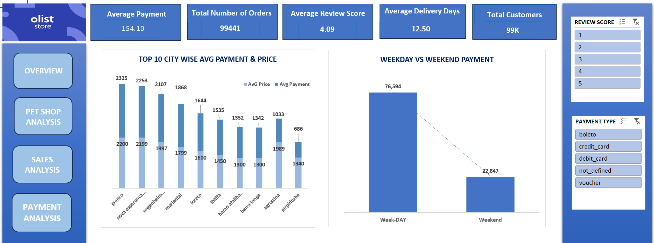
Final Strategic Recommendations
Target 11-day delivery goal
Launch September recovery campaign
Expand Sao Paulo marketing

